Slide 1

STUDENT DETAILS
Name: Gaurav Haritas
SkillsBuild Email ID: chinuharitas@gmail.com
College Name: Dronacharya College Of Engineering, Gurgaon
College State: Haryana
Internship Domain: Artificial Intelligence
Internship Start Date: 12th June 2023
Internship End Date: 24th July 2023

Slide 2
Problem Statement
The problem statement for this project is to develop an "AI Mental Fitness Tracker" that accurately tracks the mental fitness of individuals based on various factors such as Schizophrenia, Eating Disorders, Drug Use, Alcohol Use, and Depression. The project aims to analyze and predict mental fitness percentages in different countries from 1990 to 2021 using machine learning algorithms.

Slide 3
Agenda
The agenda for the presentation will be as follows:
Project overview
Target audience and their needs
Solution and value proposition
Customization and uniqueness of the solution
Modeling techniques and methodologies
Results and outcomes

Slide 4
Project Overview
The project focuses on creating an AI Mental Fitness Tracker that utilizes machine learning algorithms to track mental fitness percentages across different countries from 1990 to 2021. The purpose of the project is to provide insights into the mental health trends over time and identify patterns related to Schizophrenia, Eating Disorders, Drug Use, Alcohol Use, and Depression. The project aims to raise awareness about mental health and enable better understanding and analysis of mental fitness data.

Slide 5
Who are the End Users
The target audience for this project includes researchers, mental health professionals, policymakers, and organizations working in the field of mental health. These individuals and organizations can benefit from the insights provided by the AI Mental Fitness Tracker, as it allows them to understand the prevalence and trends of mental health disorders in different countries over the years. The solution can also help in identifying areas that require more attention and resources for improving mental health services.

Slide 6
My Solution & its Value Proposition
The AI Mental Fitness Tracker utilizes machine learning algorithms, specifically Linear Regression and Random Forest, to predict mental fitness percentages based on data related to Schizophrenia, Eating Disorders, Drug Use, Alcohol Use, and Depression. By providing accurate predictions, the solution helps end users gain a deeper understanding of the mental health landscape. The value proposition lies in the ability to identify patterns and trends, enabling informed decision-making for interventions, resource allocation, and policy development related to mental health.

Slide 7
How did you customize the project and make it your own?
This project stands out by focusing on a comprehensive set of mental health indicators and utilizing machine learning algorithms to predict mental fitness percentages. The customization includes collecting and analyzing data from various sources, training the models specifically for mental health prediction, and adapting the algorithms to the unique characteristics of mental health datasets. The project's innovation lies in its application of AI and machine learning techniques to address mental health concerns on a global scale.

Slide 8
Modeling
The project utilizes two main modeling techniques: Linear Regression and Random Forest. Linear Regression is used to establish a linear relationship between the mental health indicators and the predicted percentages. Random Forest, on the other hand, employs an ensemble of decision trees to capture complex relationships and interactions between the variables. By leveraging these techniques, the models are trained to accurately predict mental fitness percentages for different countries and time periods.

Slide 9
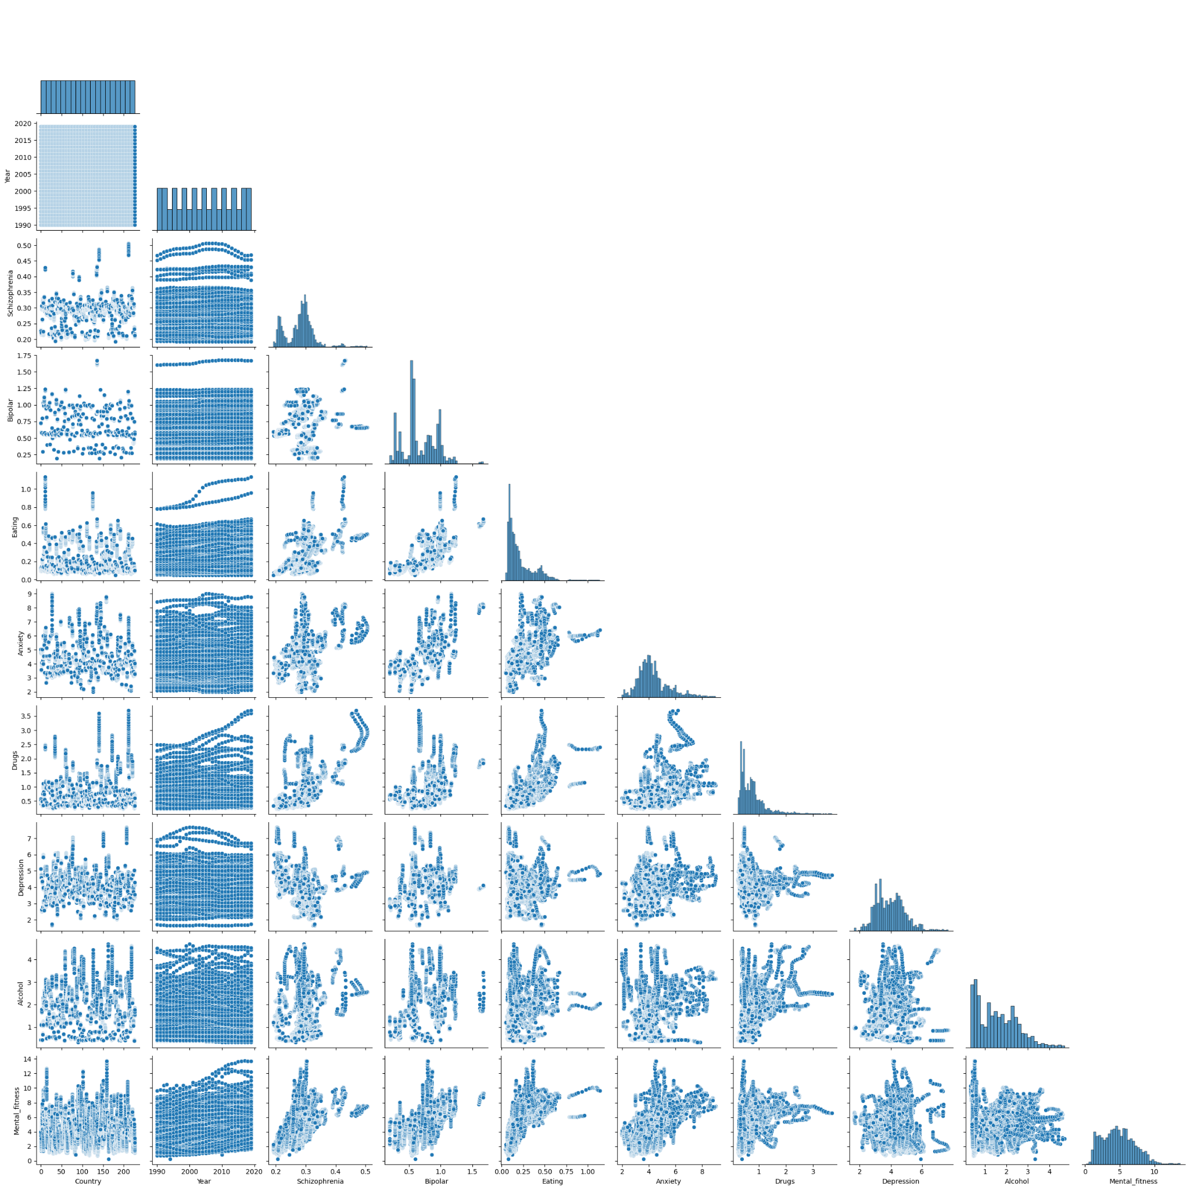
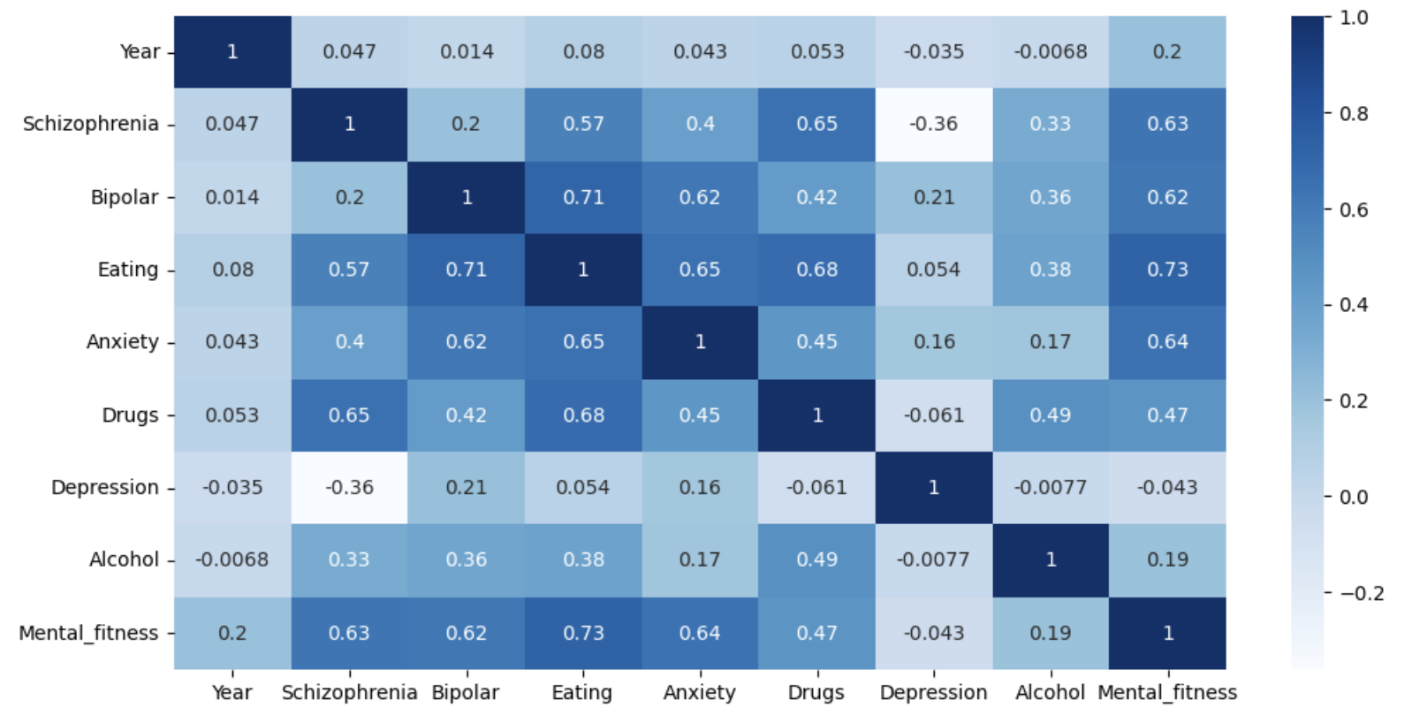
Here we can see that, "Eating Disorder" is positively correlated with "Mental_fitness" and vice-versa

Slide 10
Results
The results demonstrate that the Random Forest algorithm outperforms Linear Regression in predicting mental fitness percentages based on the given dataset. The accuracy and effectiveness of the Random Forest model indicate its superior ability to capture non-linear relationships and handle complex interactions among the mental health indicators.

Slide 11
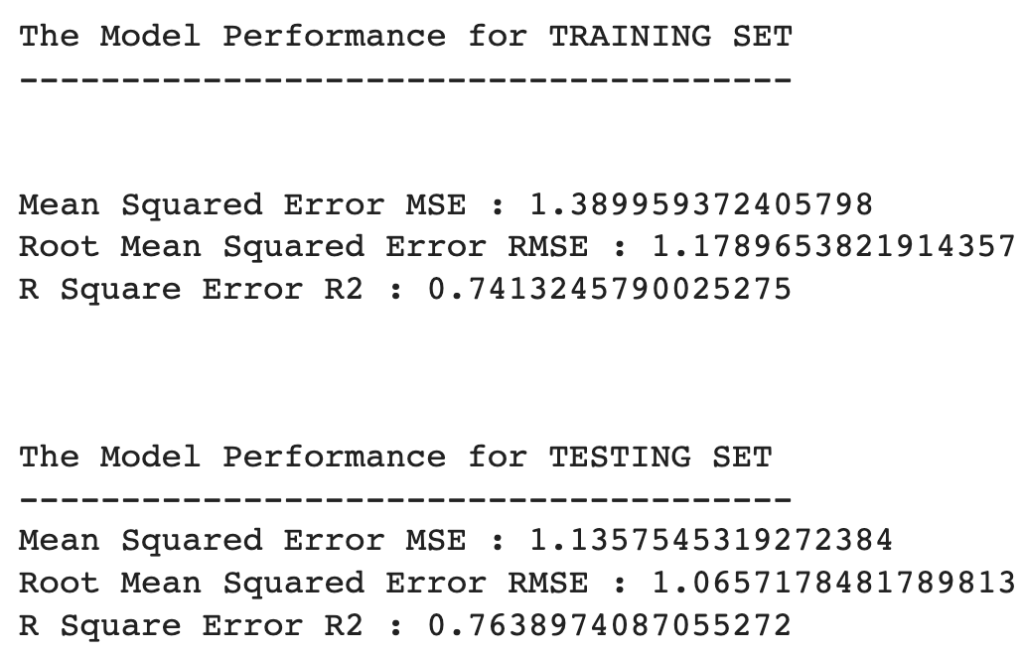
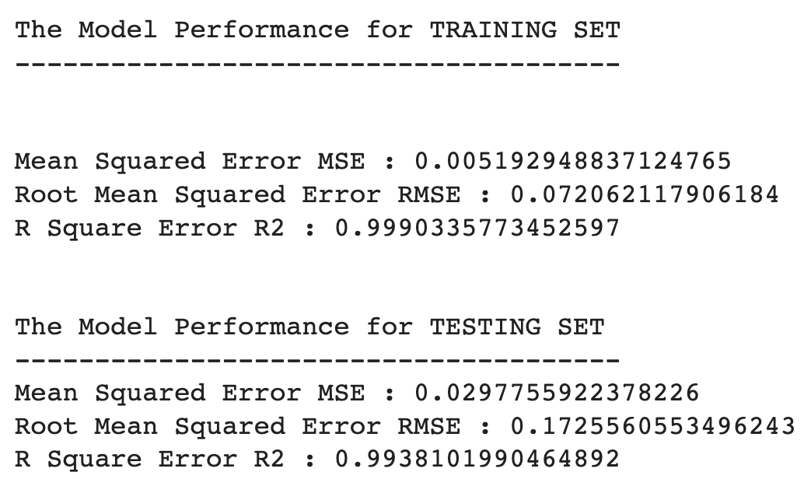
Machine Learning Algorithms Results
Linear Regression
Random Forest Regressor

Slide 12

Links
Ai Mental Fitness Tracker: Click Here
Datasets : Click Here
Prerequisites Learning: Click Here
Github: Click Here

